Slide 1

REDBUS DATA SCRAPING WITH SELENIUM & DYNAMIC FILTERING USING STREAMLIT

Slide 2
First capstone project
COURSE : DATA SCIENCE
BATCH : EVENING BATCH
BATCH CODE : MDTE13 (DS-WD-T-B10)
NAME : NANDHIN C

Slide 3
OBJECTIVES
Develop a web scraper to automate the extraction of bus route details, schedules, and relevant information from the RedBus website for multiple states.
Store the data in an SQL database
Visualize it using a Streamlit app.

Slide 4
SCOPE
Data Extraction: Scrape bus route links, names, and detailed information for each route, including bus name, type, departing time, duration, reaching time, star rating, price, and seat availability.
Automation: Automate navigation through multiple pages and states on the RedBus website.
Data Storage: Store the scraped data in an SQL database.
Visualization: Develop a Streamlit app to visualize and analyze the stored data.

Slide 5
IMPLEMENTATION STEPS
WEB SCRAPING INITIALIZE WEB DRIVER
Use selenium to open the browser and navigate to the target URL.
Handle page loading and pop-ups.
SCRAPE BUS ROUTES AND DETAILS
Identify elements containing bus routes links and names.
Navigate to each route link and extract detailed information.

Slide 6
SQL DATABASE INTEGRATION
SETUP DATABASE
Use sql to create a database and define table structures ,check whether the datatypes are same
STREAMLIT APP DEVELOPMENT
SETUP STREAMLIT
Install streamlit & create a streamlit script
DATABASE CONNECTION
Use sql to connect to the database
QUERY AND DISPLAY DATA
Fetch data from the database and use streamlit components to display it
ADD FILTERS AND ANALYSIS
Use streamlit widgets to add filters for route name,bus type etc,.
Use streamlit to analyse data

Slide 7
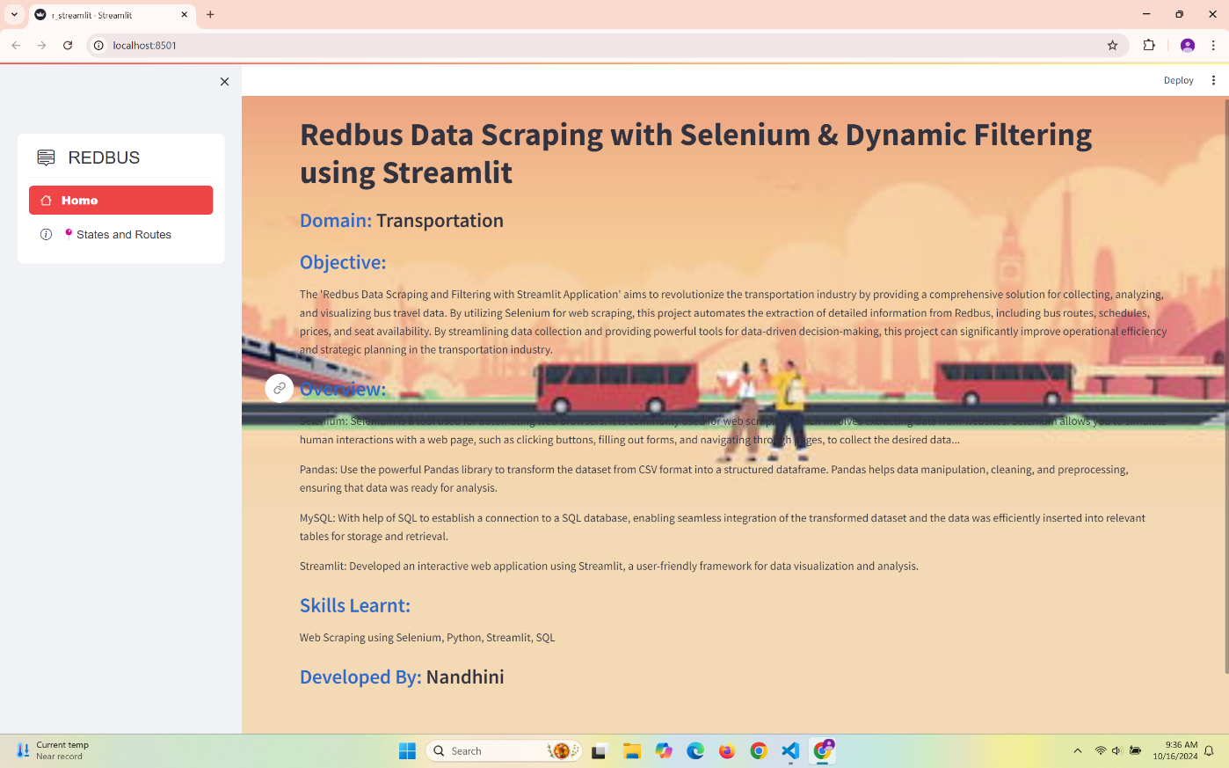
screenshot

Slide 8
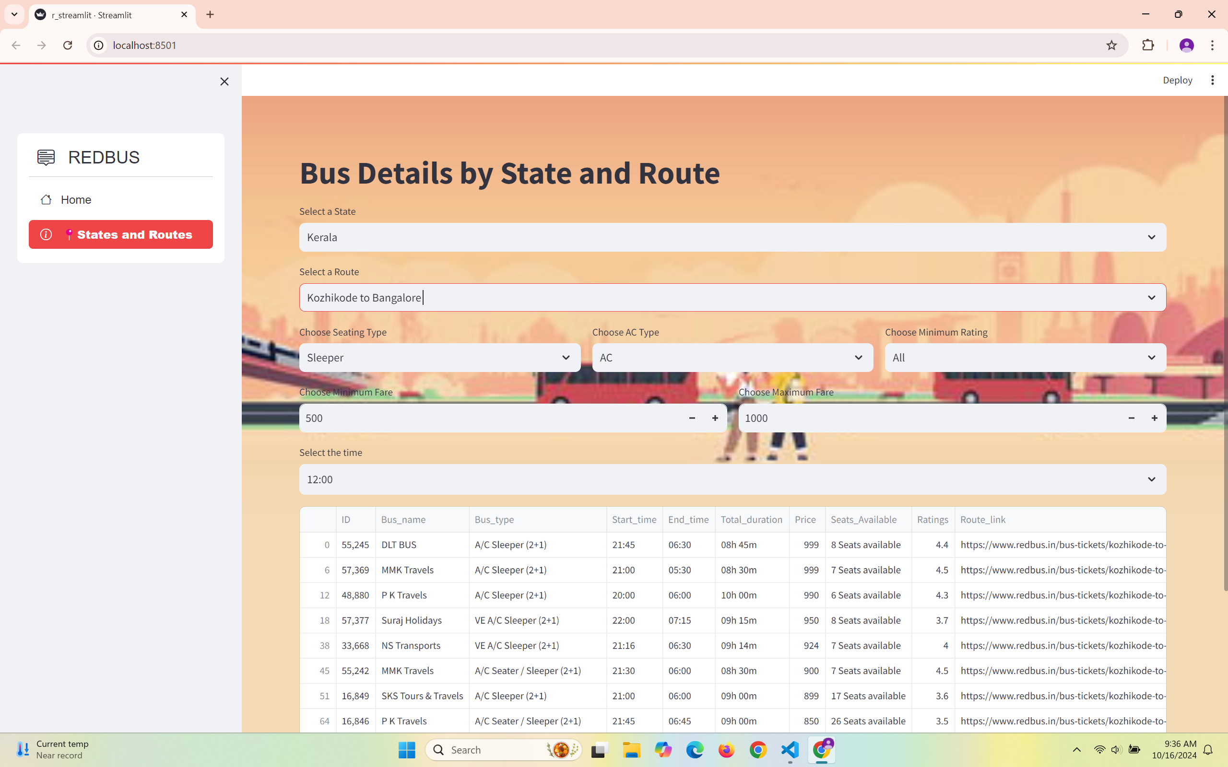

Slide 9
conclusion
By following this approach, you can automate the scraping of bus route details, store the data in an SQL database, and create an interactive Streamlit app for data analysis.

Slide 10
Thank you

